Slide 1


Simulating Crowd Behaviour
Group 13
Abbie Backers
Quincy Sproul
Conrad O’Driscoll
Anastasis Gerogiannis
Emiliyan Stefanov

Slide 2

Introduction
[1]

Slide 3
Aims
Develop Models
Analyse
Suggest

Slide 4
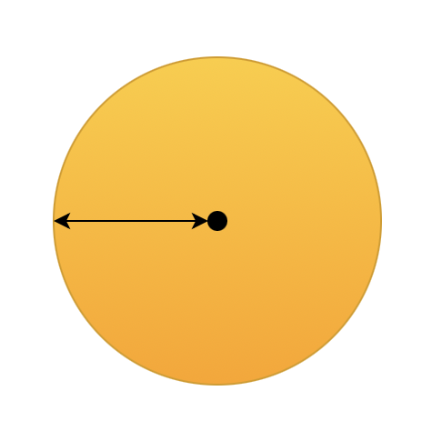
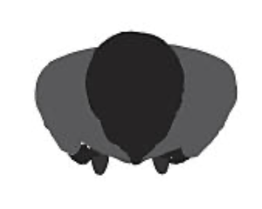
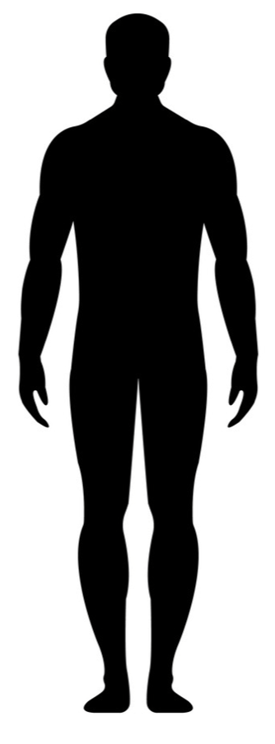
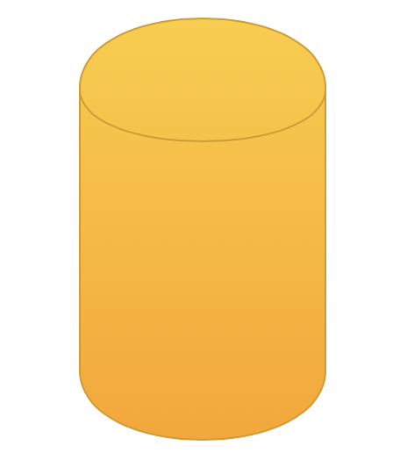
Modelling Agents
R
Uniform Height

Slide 5
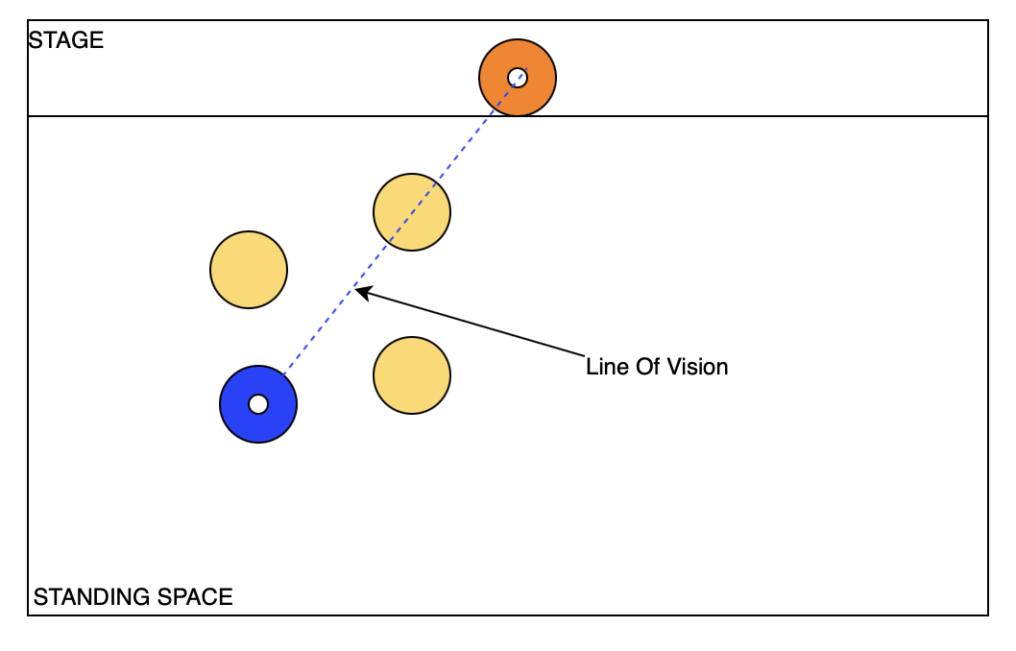
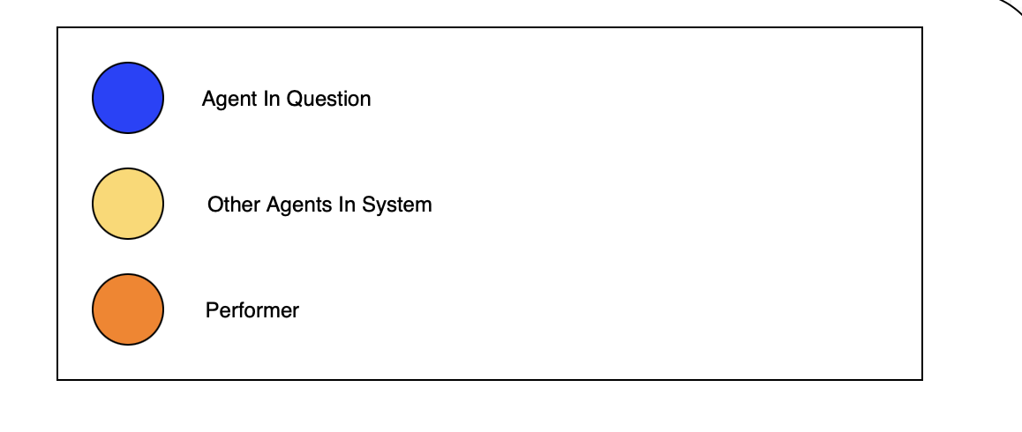
Modelling Vision (1)
Line of Vision = Blocked
Agent in question cannot see the performer

Slide 6
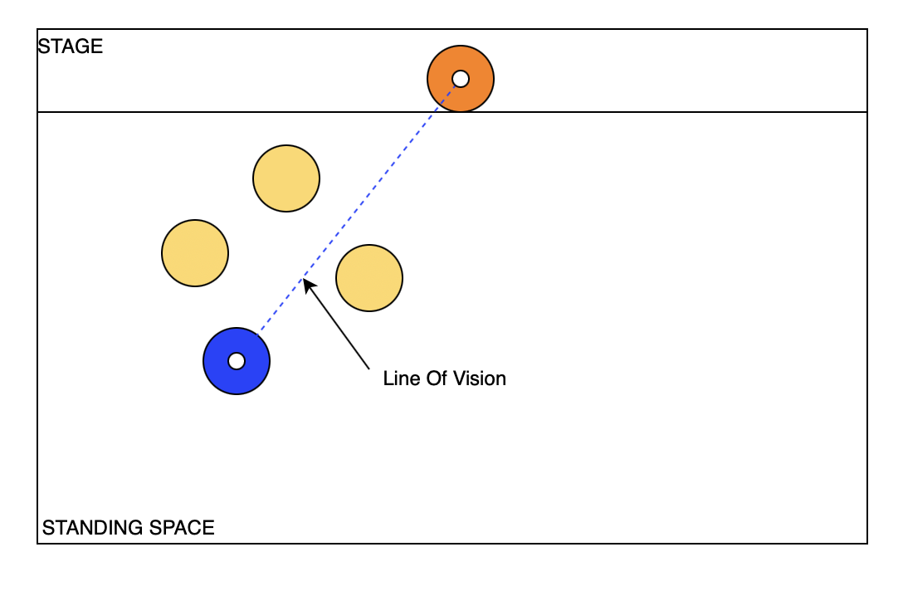
Modelling Vision (2)
Line of Vision = Clear
Agent in question can see the performer

Slide 7
Discrete Model
Random Distribution Of Agents
Visibility Check
Movement
>2R

Slide 8
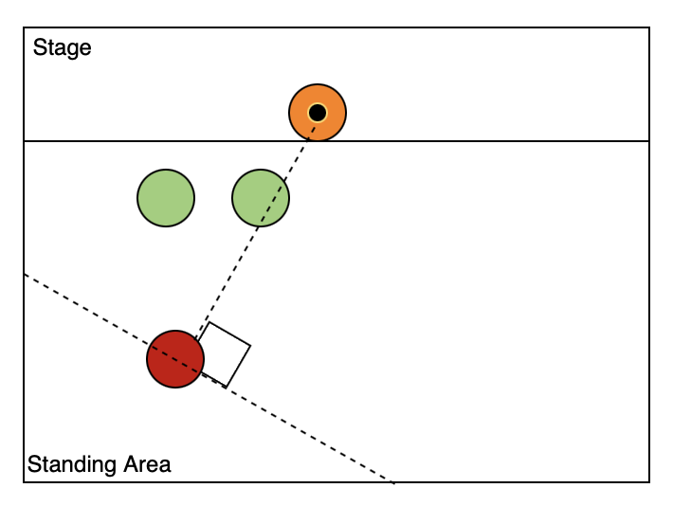
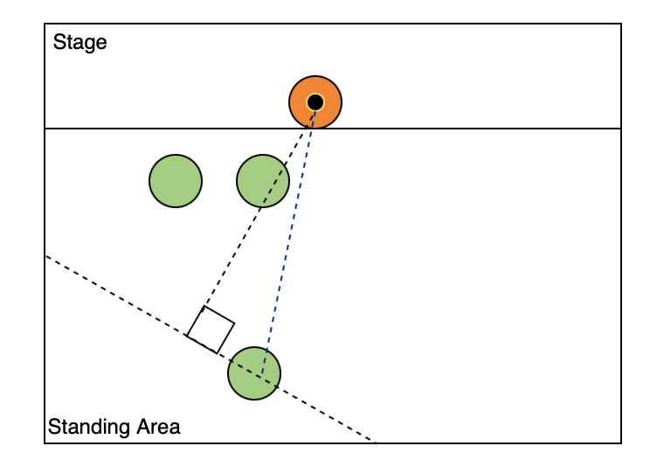
Modelling Movement - Discrete Model
Red = Obstructed Line of Vision
Move Randomly (L or R) in direction perpendicular to line of vision
Green = Unobstructed Line of Vision
Remain Stationary!

Slide 9
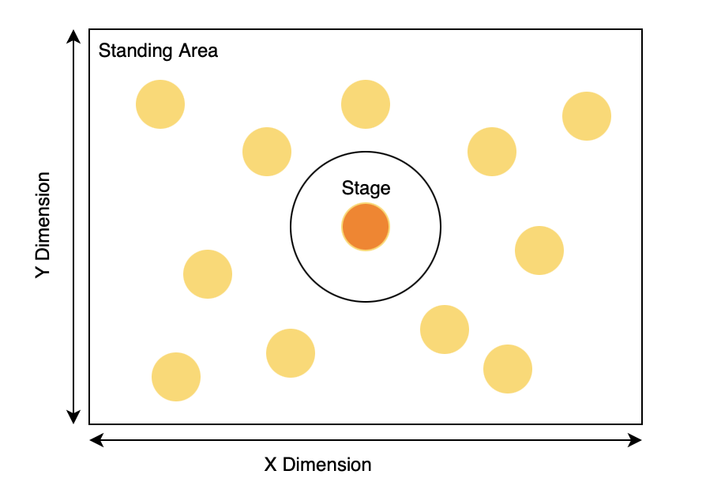
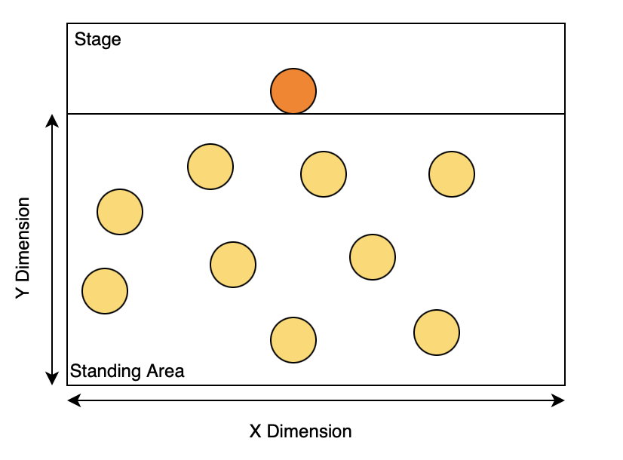
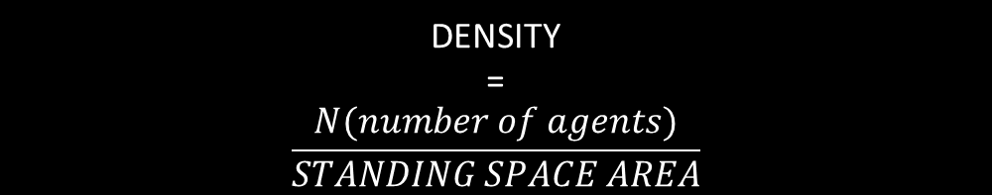
Results…
Circular Stage
DENSITY
=
$$\frac{N(number of agents)}{STANDING SPACE AREA}$$
Rectangular stage

Slide 10
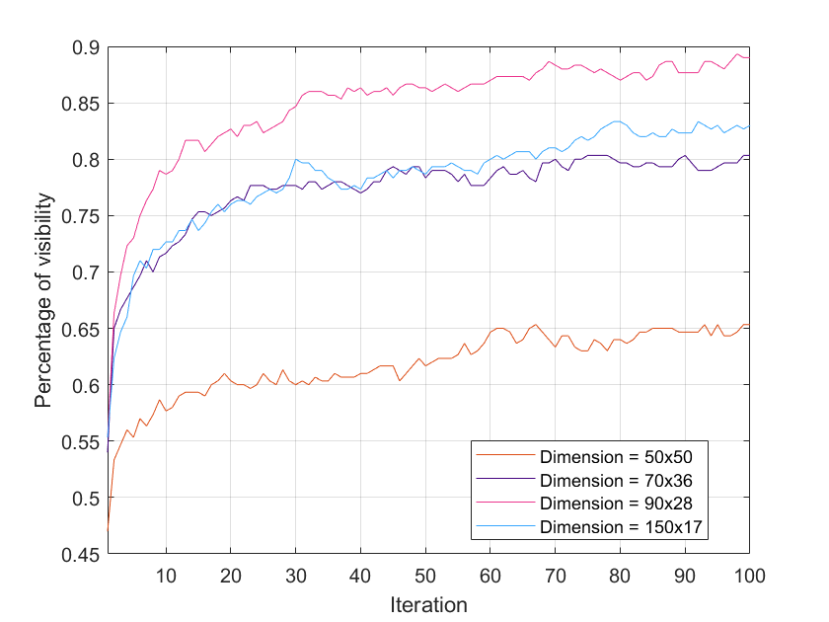
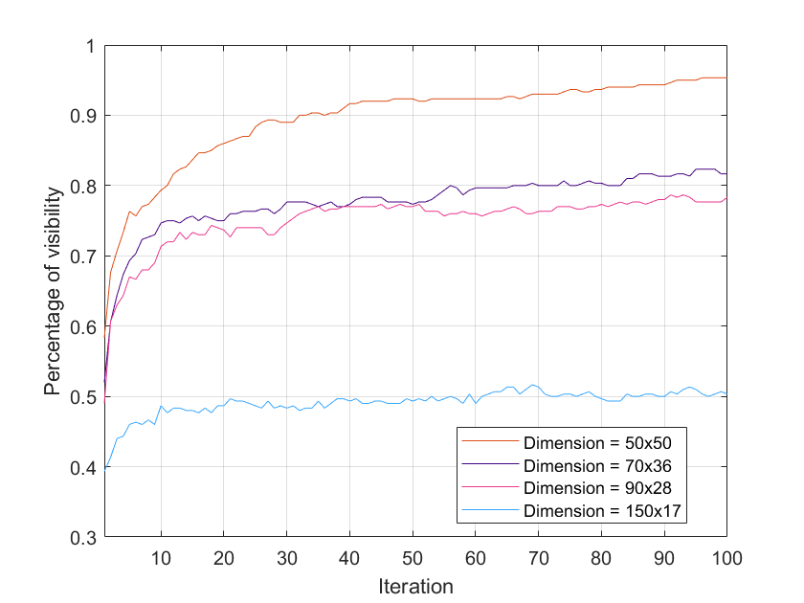
The Effect of Standing Area Dimensions on Visibility
Rectangular Stage
Circular Stage
N=300
R=0.15m
longer X dimension (up to a threshold) →
larger visibility
‘close’ to square shaped areas
→
larger visibility
aspect ratio>2.5→ rectangular stage
‘Close’ to square shaped venue → circular stage

Slide 11
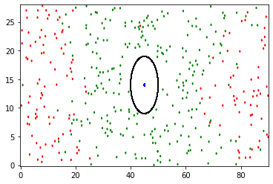
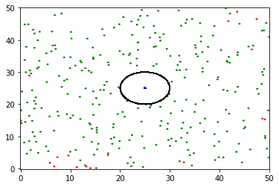
Circular stage results explanation
Rectangle
Square
agents near the sides of the smaller dimension
→
many columns of agents ahead (along the larger dimension)
→
visibility decreases
square shape
→
fewer columns of agents
→
higher visibility

Slide 12
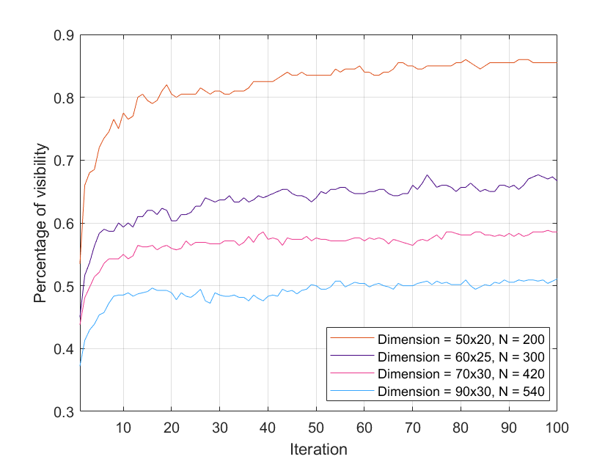
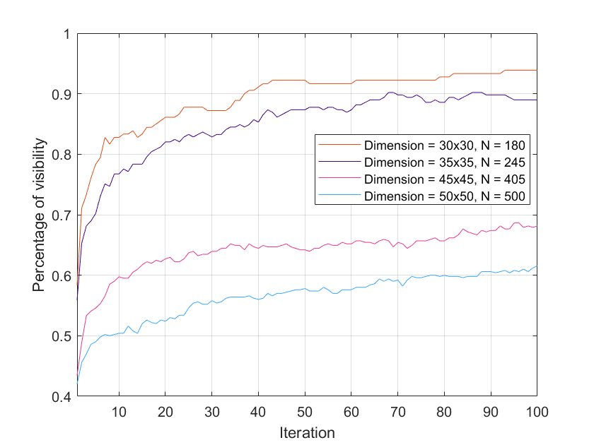
The Effect of Standing Area on Visibility with Constant Density
=
Rectangular Stage
Circular Stage
Density = 0.2
R = 0.15m
same density ≠ same visibility
smaller area with same density
→
increase in visibility

Slide 13
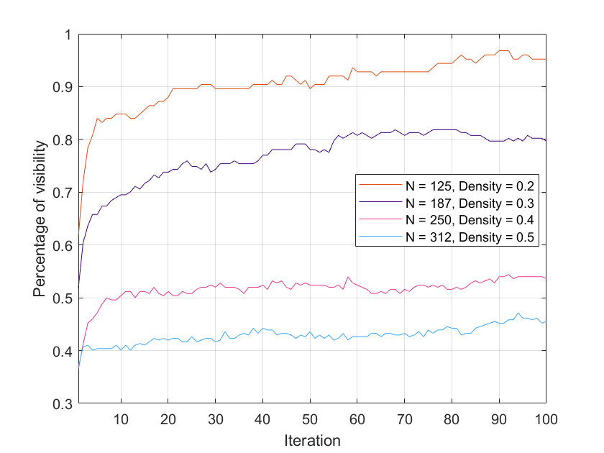
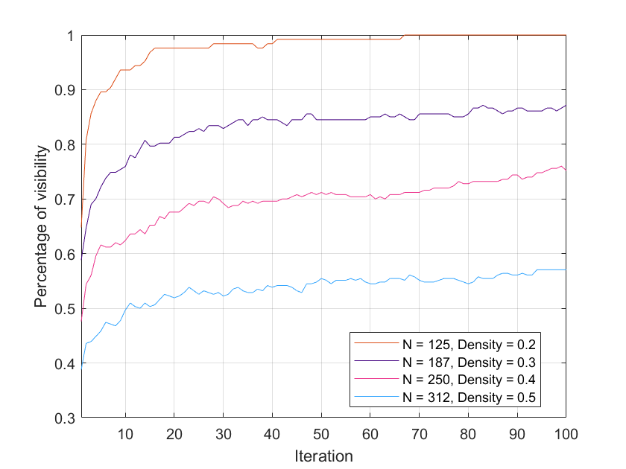
The Effect of Agent Density on Visibility with Constant Standing Area
Rectangular Stage
Circular Stage
R = 0.15m
52x12m²
25x25 m²
Circular stage achieves higher visibility for the same density

Slide 14
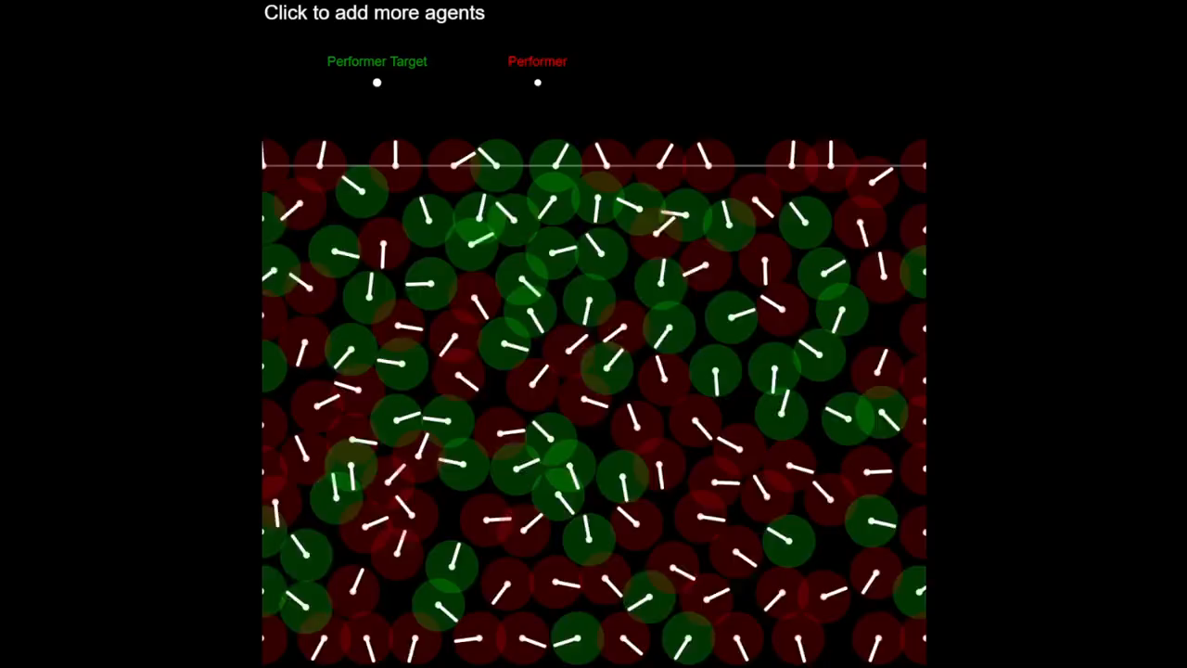
Continuous Model
Autonomous Nature
‘Boids’ Algorithm
Separation and Seek Behavior
Models Scenarios:
Moving Performer
Alternate Agent Desire
This video shows the continuous model with parameters:
Density = 1 (full capacity)
Dimension = 50x50
* The white lines represent agent’s velocity, not line of sight.
[2]

Slide 15
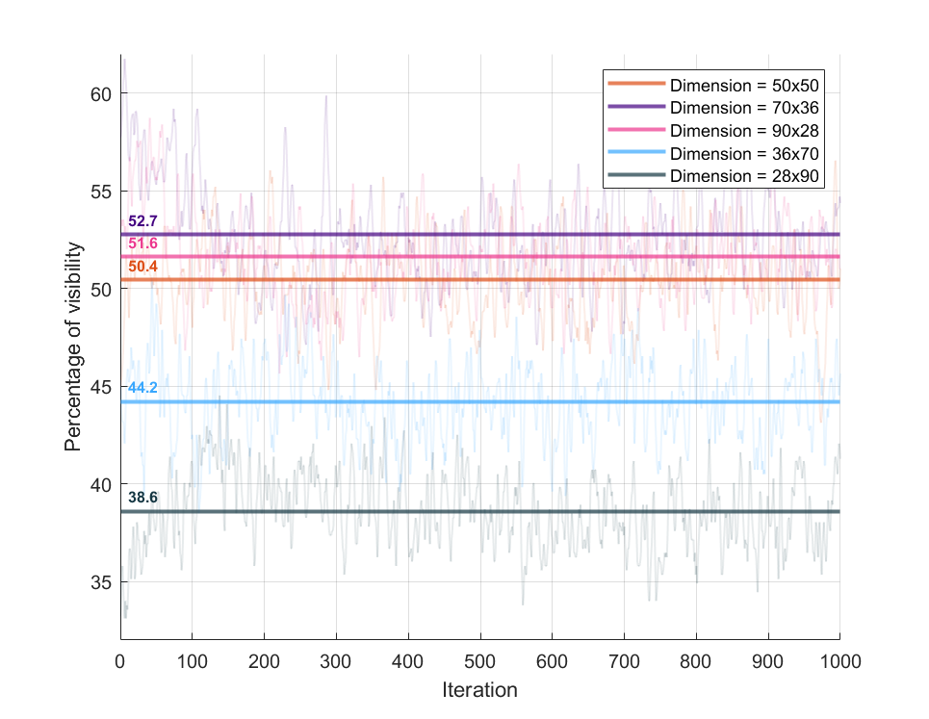
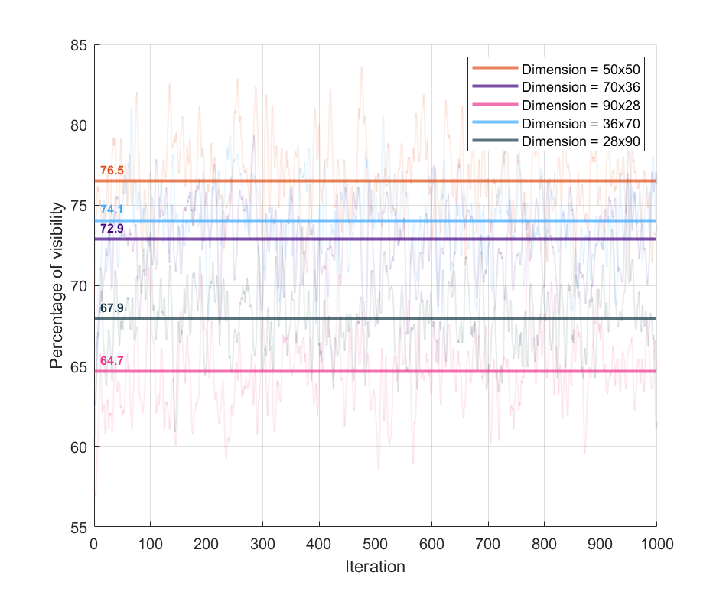
The Effect of Standing Area Dimensions on Visibility for a Stationary Performer
Rectangular Stage
Circular Stage
Density = 1 (full capacity)
*Graphs show mean visibility (horizontal lines). Translucent lines represent raw visibility data.

Slide 16
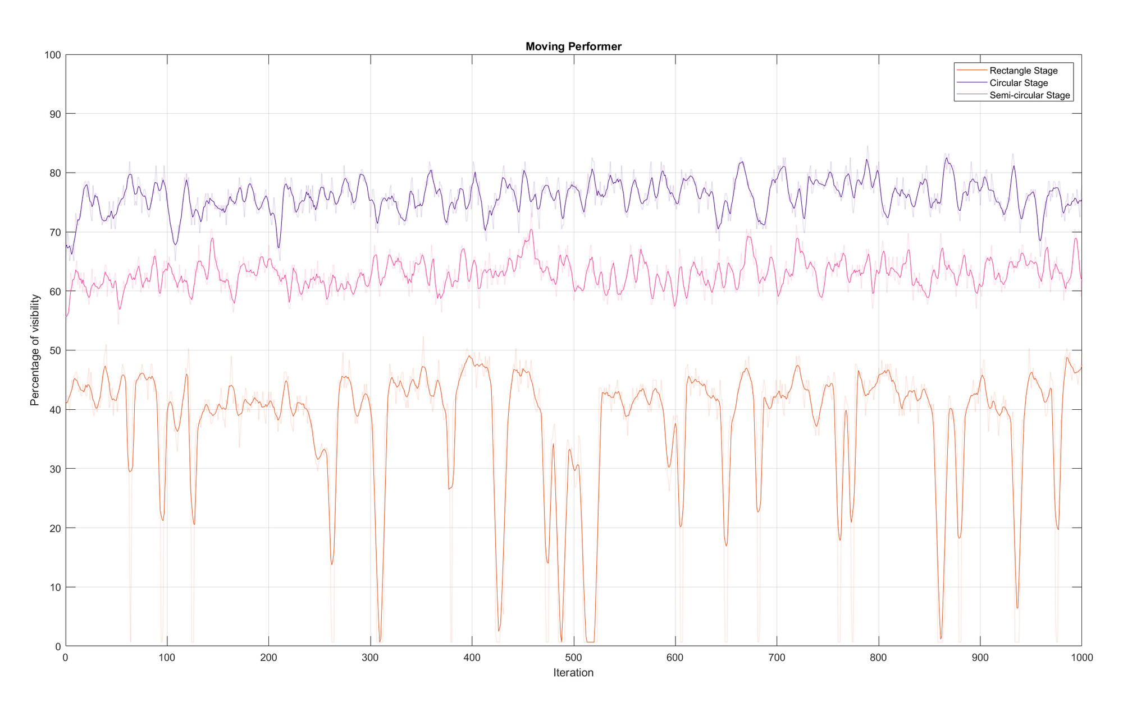
Comparing the Visibility for a Moving Performer
50x50m²
*Graph shows smoothed visibility. Translucent lines represent raw visibility data.
Density = 1 (full capacity)

Slide 17
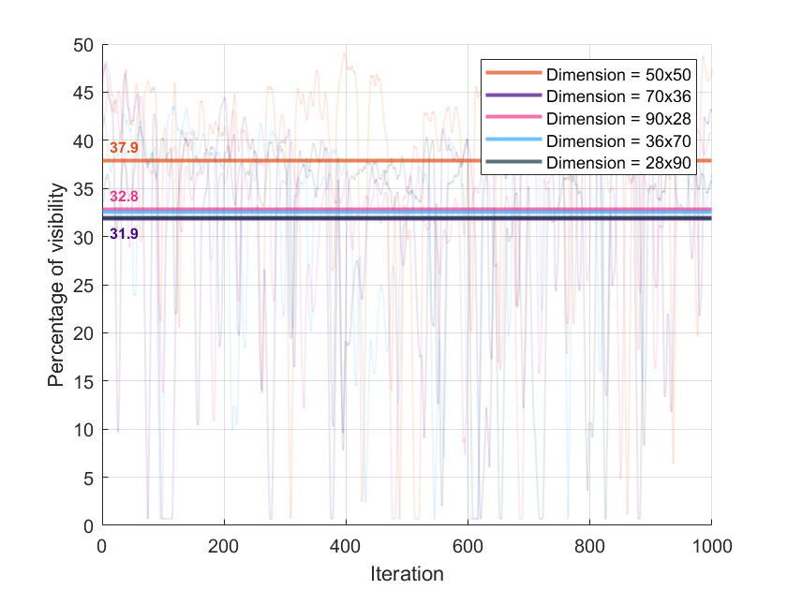
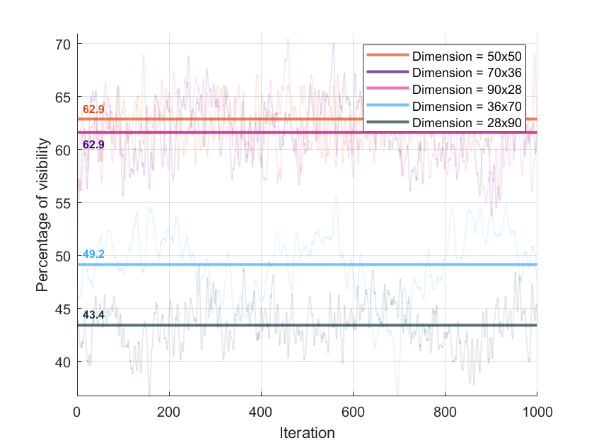
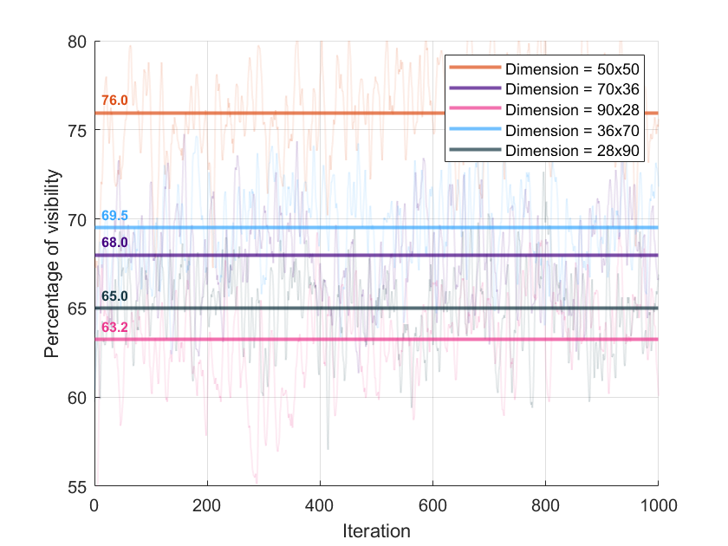
The Effect of Standing Area Dimensions on Visibility for a Moving Performer
Rectangular Stage
Semi-circular Stage
Circular Stage
*Graphs show mean visibility (horizontal lines). Translucent lines represent raw visibility data.
Density = 1 (full capacity)

Slide 18
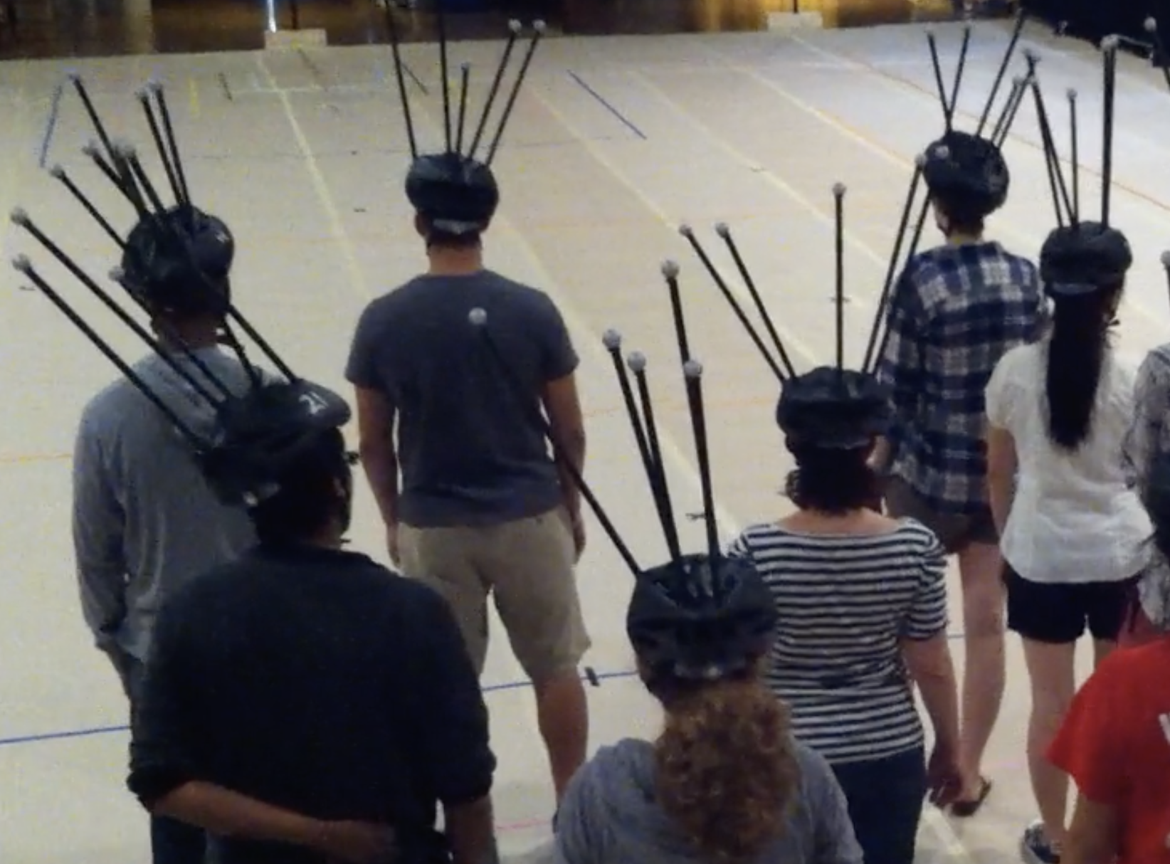
Suggestions – Experimental Data
Method=Motion Capture Helmets
Pioneered by William Warren
Can be used to verify results
[3]

Slide 19
Conclusion
uniform width, height → not realistic results but good initial approximation
dependency of the alternative suggestions on the relevant parameters
models different by design but fairly similar results → validity of results

Slide 20
Limitation/further improvements
different heights and widths with statistical distribution
discrete model: comparison of different modeling of movement of agents with no visibility
continuous model: more motivating factors, e.g., sticking to groups, or increasing number of performers
experiments with more values of parameters → computational complexity

Slide 21

References
[1] João E. Almeida, Crowd Simulation Modelling Applied to Emergency and Evacuation Simulations using Multi-Agent Systems, 2013.
[2] Craig W. Reynolds, Steering Behaviors For Autonomous Characters, 1999.
[3] William Warren, Behavioral Dynamics of Heading Alignment in Pedestrian Following, 2014.

